Slide 1

Welcome
Welcome to Online Mentoring Orientation for 2021 Spring

Slide 2
1.
What is Mentoring?
A mentoring program is an activity that has a mutual impact between the mentor who helps and the mentee who receives the help.
“Our university mentees and mentors
work together to help each other academically,
emotionally, and successfully adapt to their university life.”

Slide 3
2.
Mentoring Program Overview – 1/5
A. Purpose
▸ Enhancement of international students' adaptation to life in Korea
▸ Reinforcement of multicultural experiences and communication skills between Korean and international students
B. Target and Configuration
▸ Target : International student and Korean undergraduates
▸ Configuration : 1 international student – 1 Korean student
C. Activity Period : 2021. 03. 12.(Fri) ~ 2021. 06. 13 (Sun) 13 weeks

Slide 4
2.
Mentoring Program Overview – 2/5
D. Principles and Activity Compliance
▸ Mentoring once every two weeks (basic 2 hours) and at least 14 hours per semester
▸ Submit a mentoring activity report (at least 7 times in 13 weeks) once a week
▸ Activity reports must be submitted each time after the activity
(Do not collect and submit all at once)
▸ Teams who give up halfway during mentoring activities are not eligible for funding
▸ After confirming compliance with the activity hours and submitting the activity report, fund (100,000 won) is paid at the end of the activity with a bankbook under the name of the mentor

Slide 5
2.
Mentoring Program Overview – 3/5
[Let's always be careful! ]
▸ Exchange contacts with each other during the mentor and mentee first meeting
▸ The mentor and the mentee must follow the time set to meet.
▸ When talking with the mentee, speak slowly and clearly.
▸ Repeat to ask and confirm that the mentee is clearly understood.
[Do these activities! ] - Activity example (13 weeks)
▸ At the first meeting: Make a semester's activity plan and share it with the mentee, identify whether there are other activities the mentee wants, and modify the plan.

Slide 6
2.
Mentoring Program Overview – 4/5
▸ Teach how to use the university’s website (Notice board, free bulletin board, KLAS)
▸ Teach how to use Student Service Center (Issuance of grades/certificate of enrollment)
▸ Help the mentee with classes and assignments (Not doing it instead!)
▸ Go to the library and inform them about borrowing/returning books, use of the reading room, etc.
▸ Inform the mentee's department office and college teaching team
▸ Teach how to use the school cafeteria/post office/photocopying room, and where internet access is available

Slide 7
2.
Mentoring Program Overview – 5/5
▸ Tell them about shops and bank locations near campus, how to use ATMs, etc.
▸ Practice Korean conversation by role-playing in a variety of situations
▸ Tell us new or foreign words that don't appear in the dictionary
▸ Mentor-Mentee Language Exchange
▸ Teach how to use public transportation (transit method, transportation card charging method, station, etc.)
▸ Introducing Korean culture (greetings, conversation etiquette, table manners, etc.)
▸ Guide to tourist attractions such as historic sites in Seoul

Slide 8
3.
Activity Fund and Report Submission
A. How to Get Activity Fund
▸ Payment after the end of the activity (in July-August 2021)
▸ Submission of fund deposit account: To be announced later
▸ Teams who give up during mentoring activities are not eligible for support
B. Submission of Activity Report (Both Mentor and Mentee)
▸ Mentor : At least 7 times
▸ Mentee : Once during the activity period

Slide 9
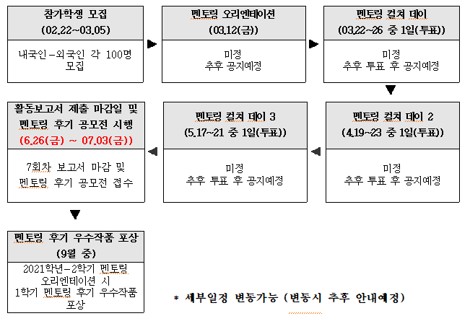
4.
Schedule
모집기간은 상황에 따라 변동가능

Slide 10
5.
Mentoring Review Contest Information
Contest application period: (6.14(Mon) ~ 6.18(Fri))
Eligibility : Participants of the 2021 Spring Mentoring Program (Students who have completed)
Contest details
Contest | Free format in the form of a photo-essay!
Content | ❍ Photos and stories of experiences from participating in mentoring program
Submission method | ❍ Visit OIA Office or Email (yerimuiwtx@kw.ac.kr)
Entry | One submission per team
Prizes | ❍ Competition Awards ❘Best Work (1 team) ❘Excellent work (2 teams) ❘Encouraging Work (3 teams)

Slide 11
Mentoring Participants’ Kakao Open-chat
6.
Please enter for communication such as mentoring culture day and other information (Mandatory) https://open.kakao.com/o/g3Gqnz0c
Password: 2021

Slide 12
The End

