Slide 1
HiKorea(www.hikorea.go.kr)
How to apply online with e-Application

Slide 2
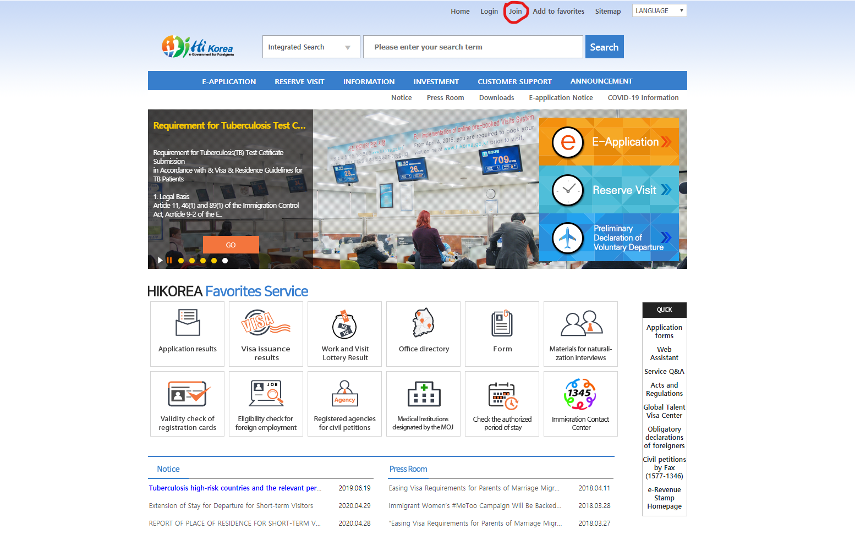
1.
Visit Hi Korea homepage（https://www.hikorea.go.kr/pt/main_en.pt）
Click “Join” to sign up
（You can change the language on the site (English, Chinese, Korean)）

Slide 3
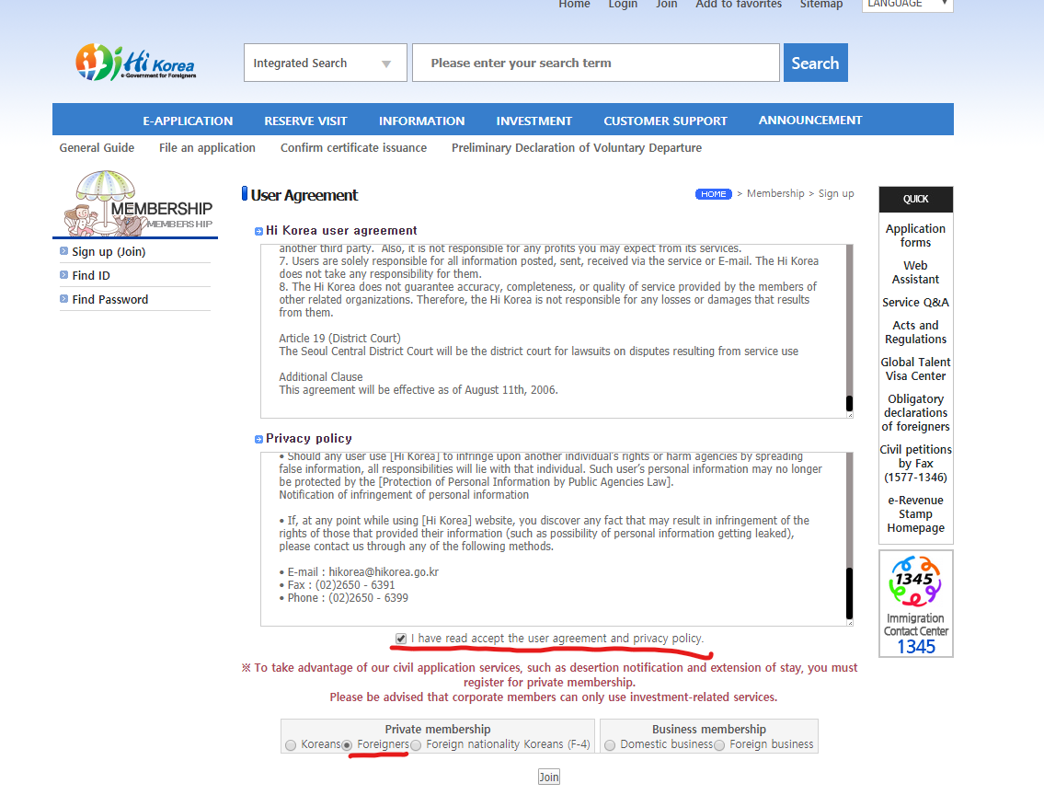
2.
Agree the user agreement and privacy policy
Choose “Foreigners” in Private membership tab
Click ‘Join’

Slide 4
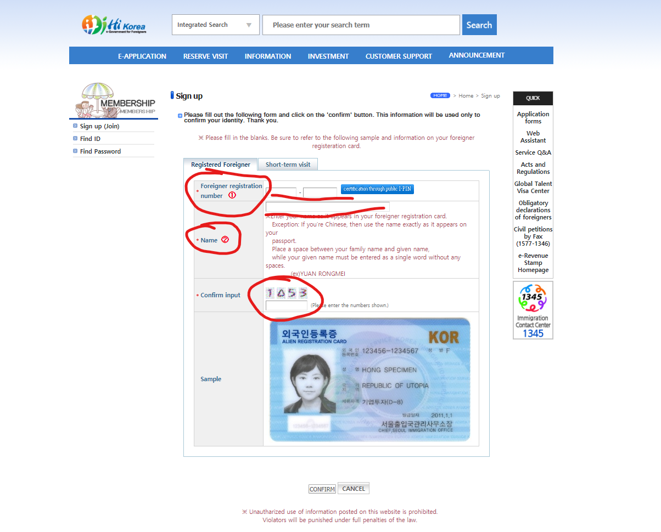
3.
Enter Foreigner registration number, Name(Same as alien registration card) and confirm input
（No need to certify through public I-PIN）
Click “confirm”

Slide 5
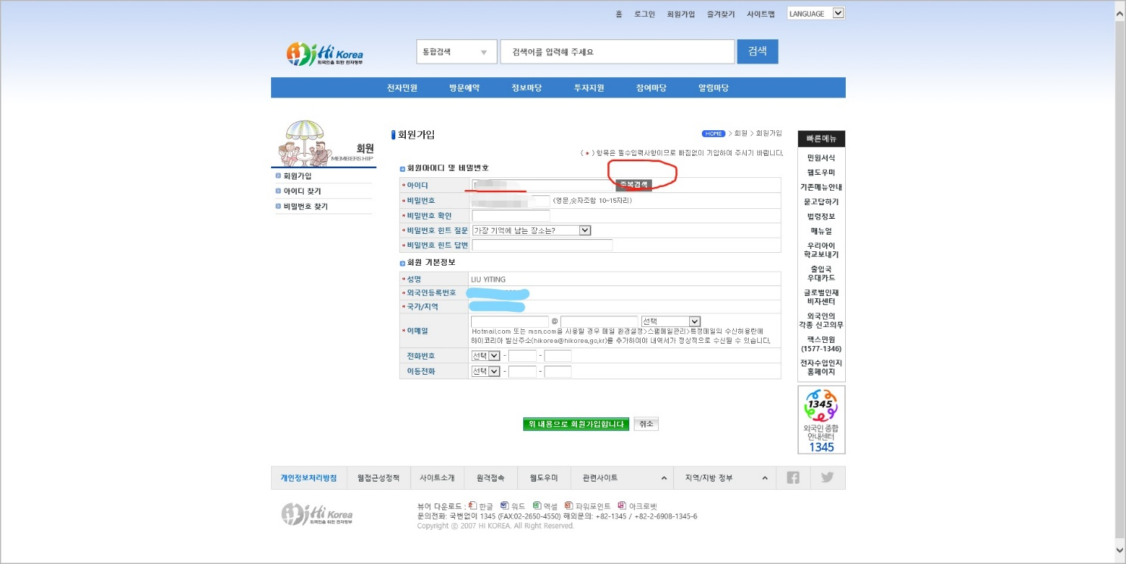
4.
Create username, and click ‘verify’
Create password (Combination of text and numbers, 10-15 letters)
After verifying, enter email and contact number
Click the green button for next page

Slide 6
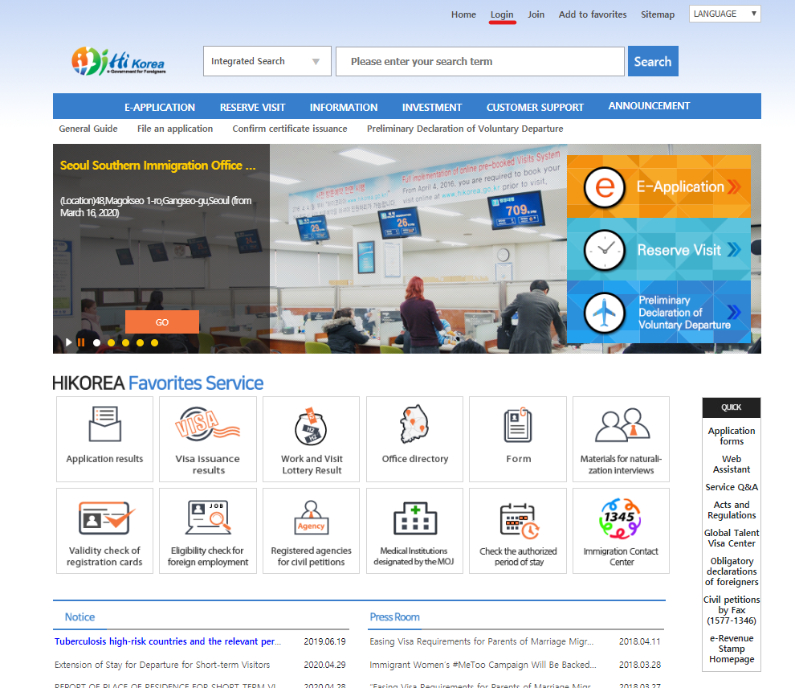
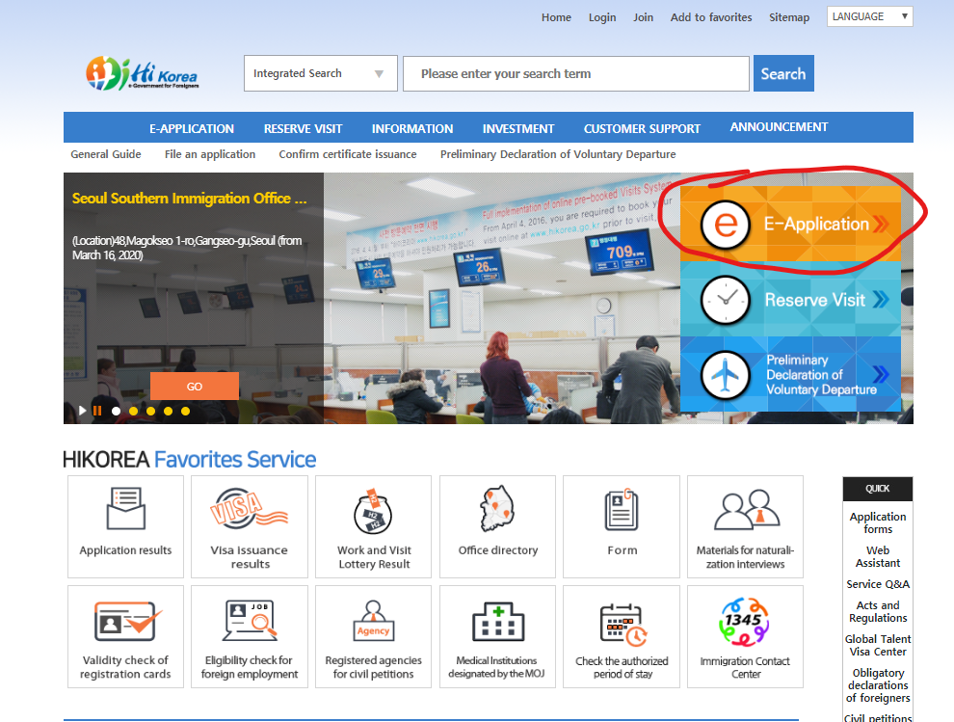
5.
After signing up, click ‘login’ at the top of the page
After logging in, click E-Application

Slide 7
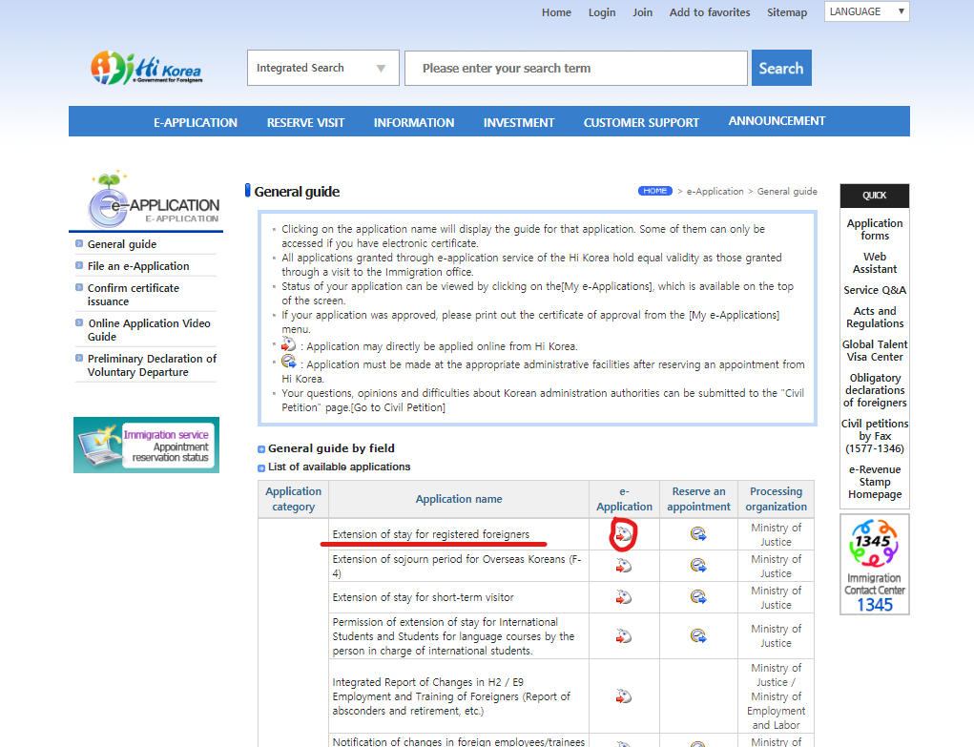
6.
After clicking “e-application” go to this page
Click the icon next to “Extension of stay for registered foreigners”

Slide 8
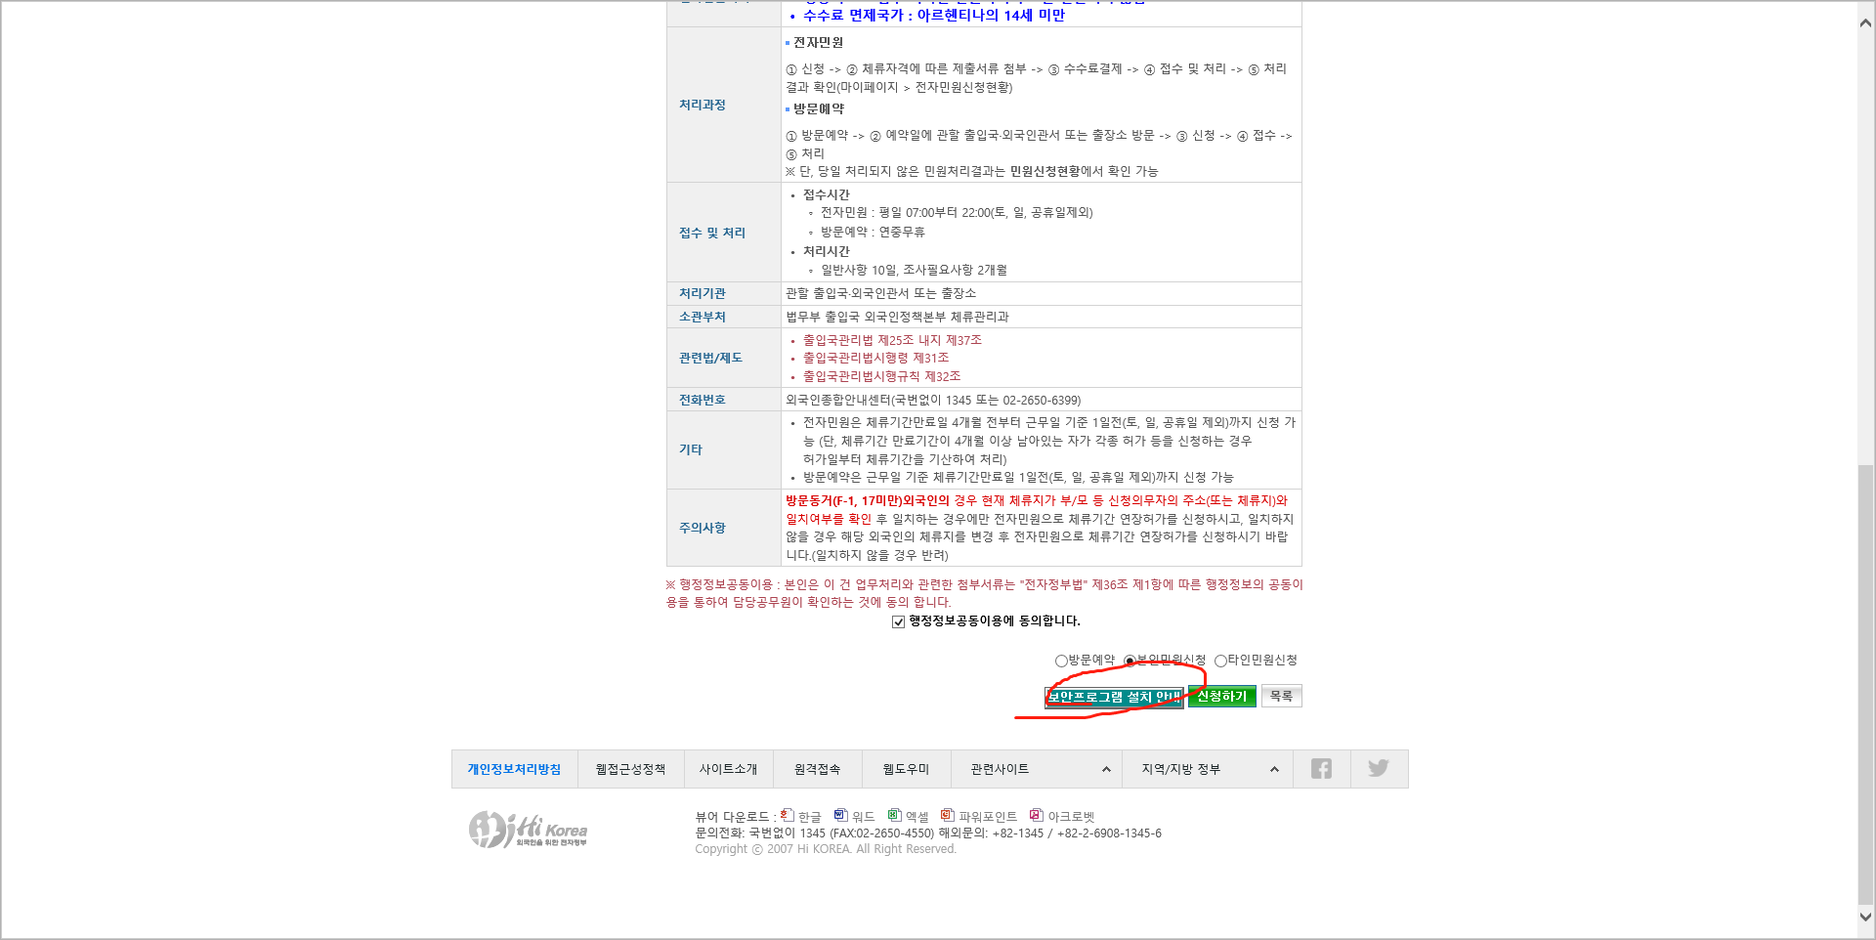
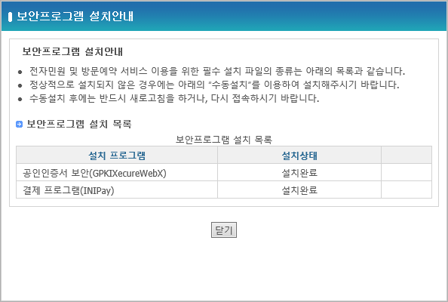
7.
Install the required security programs as shown in the picture

Slide 9
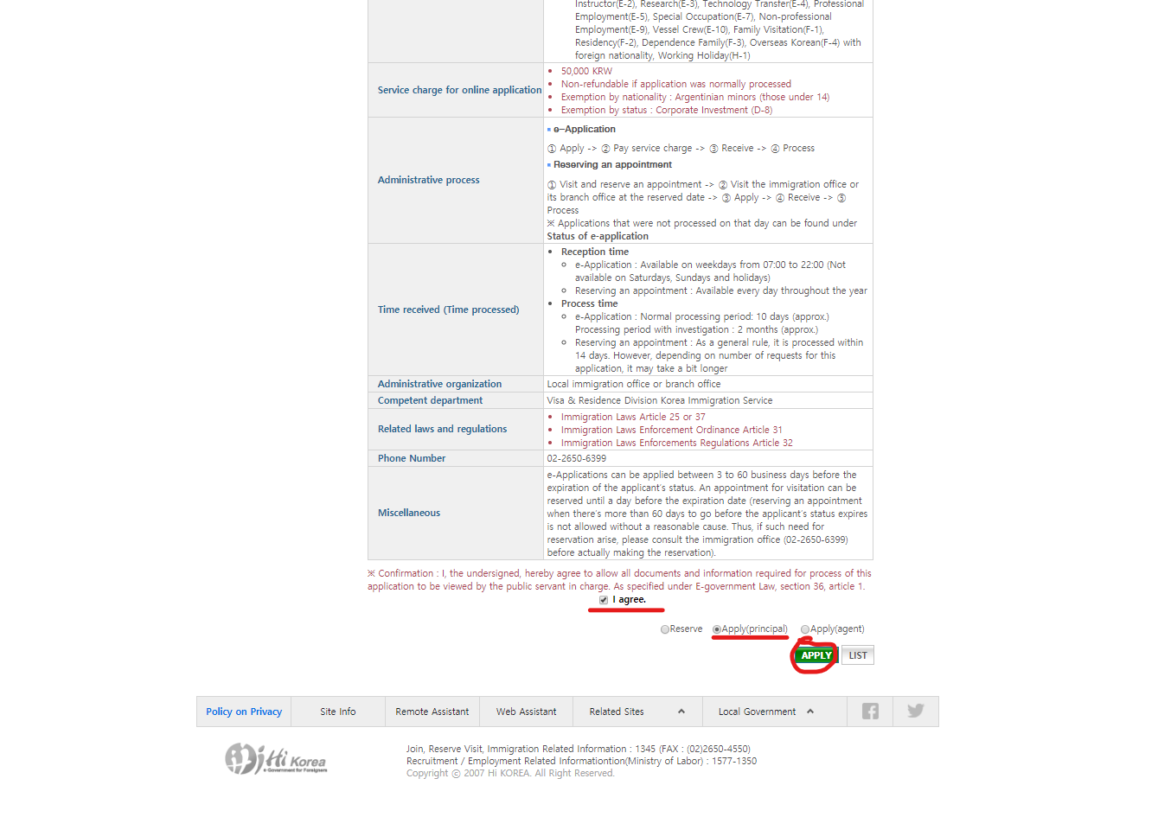
8.
Click green button to proceed to next step

Slide 10
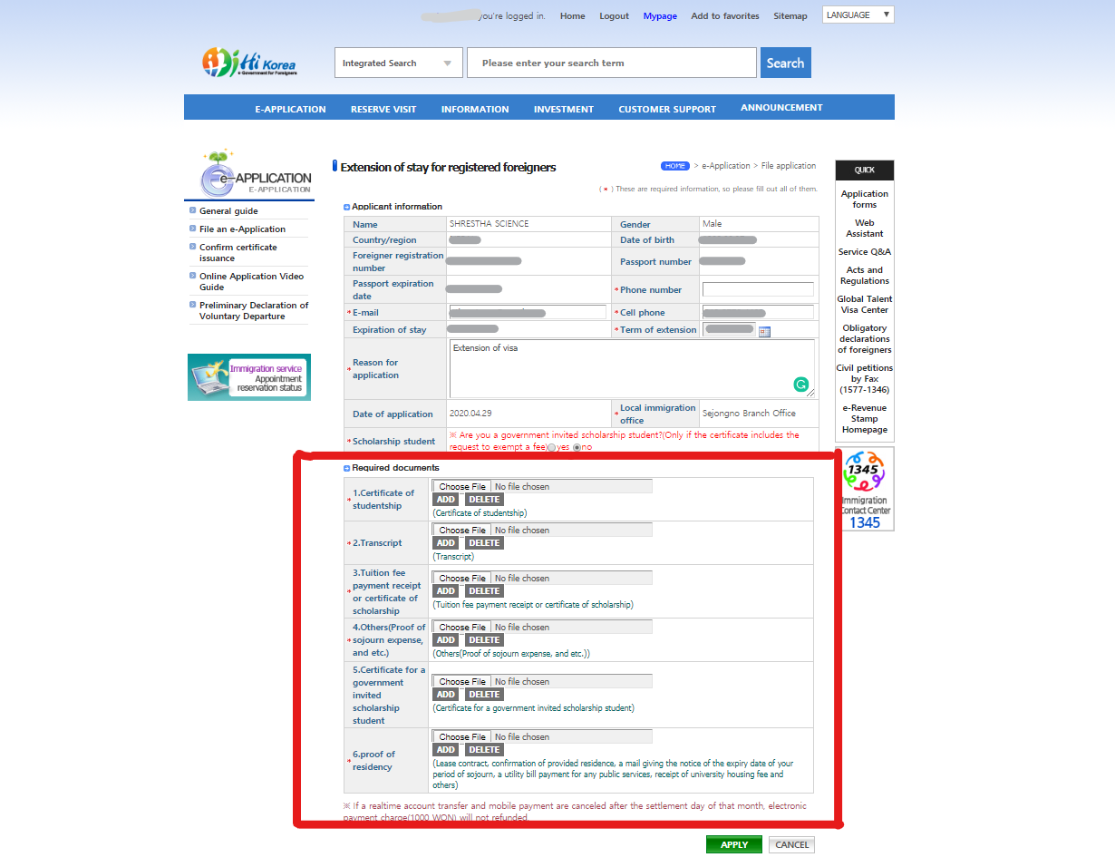
9.
After verifying the personal information here, enter the personal information and enter the 'extension of visa' in [reason for application].
After entering, scan the required documents and upload
After uploading, click the “apply” button
Application complete

